Slide 1
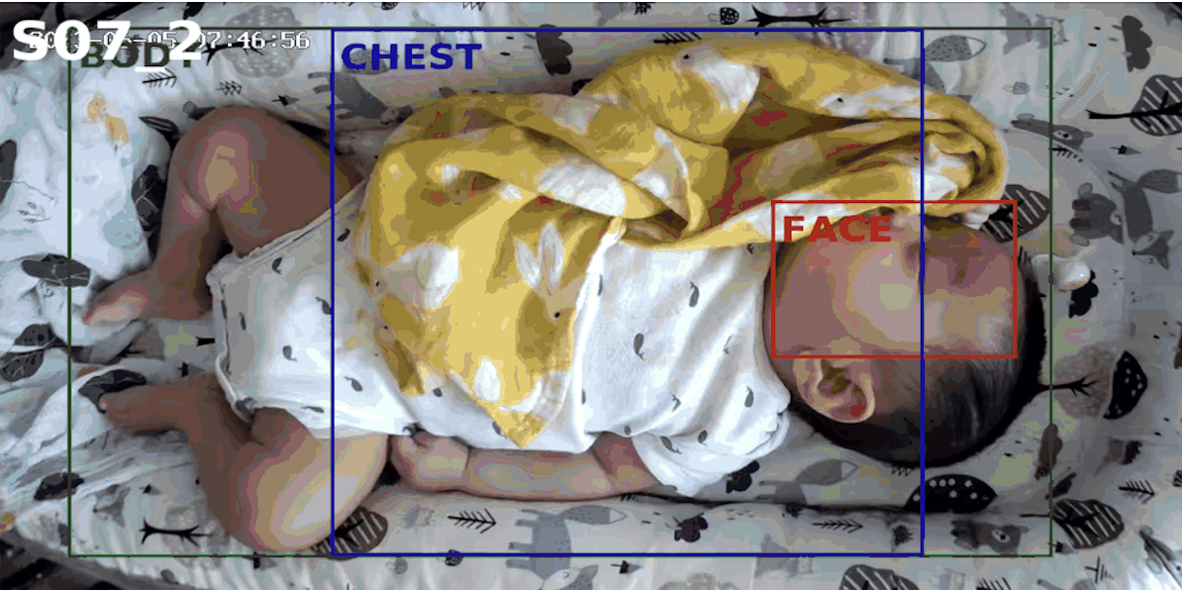
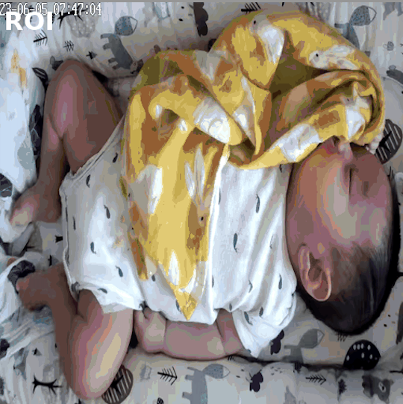
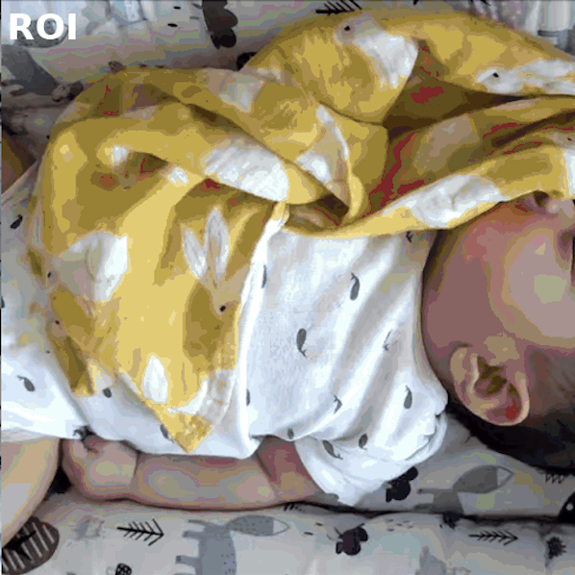
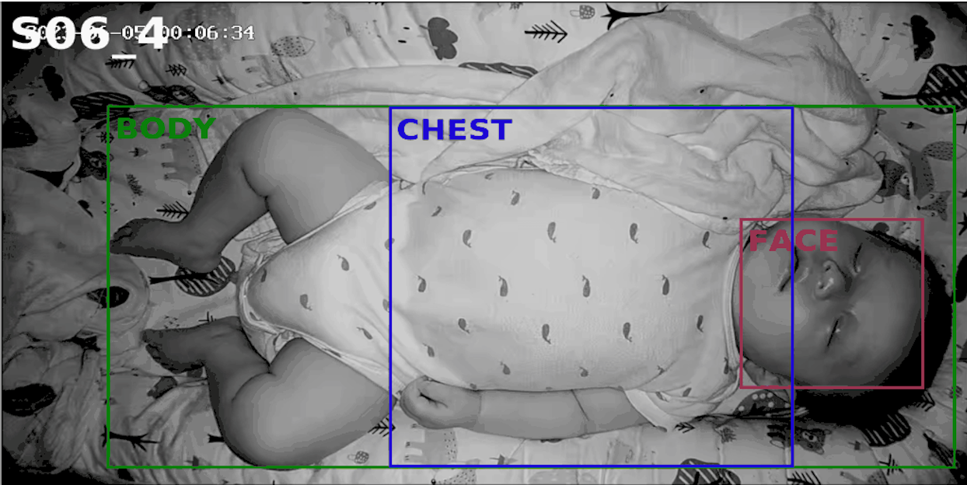
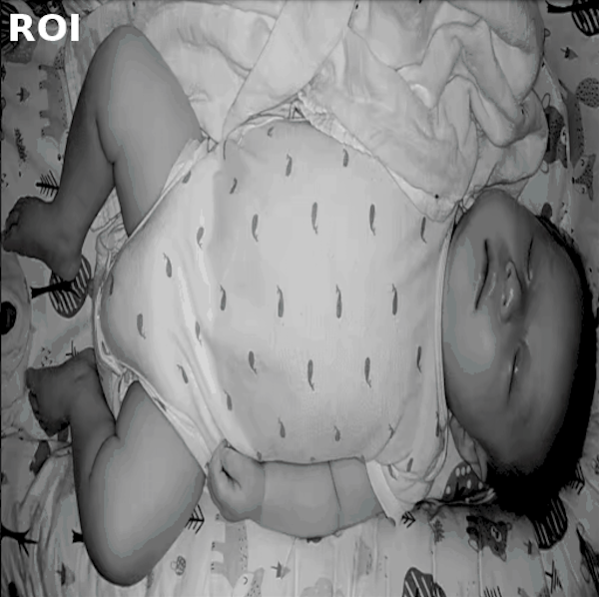
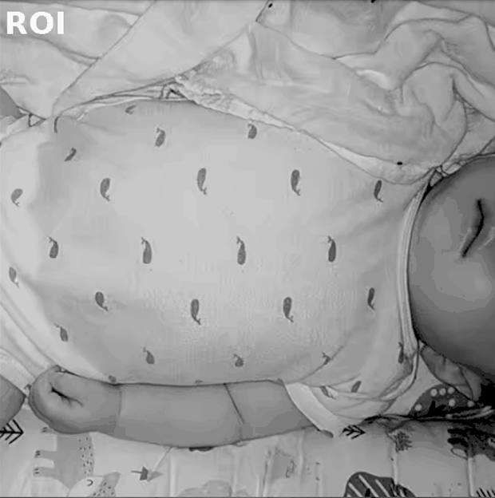
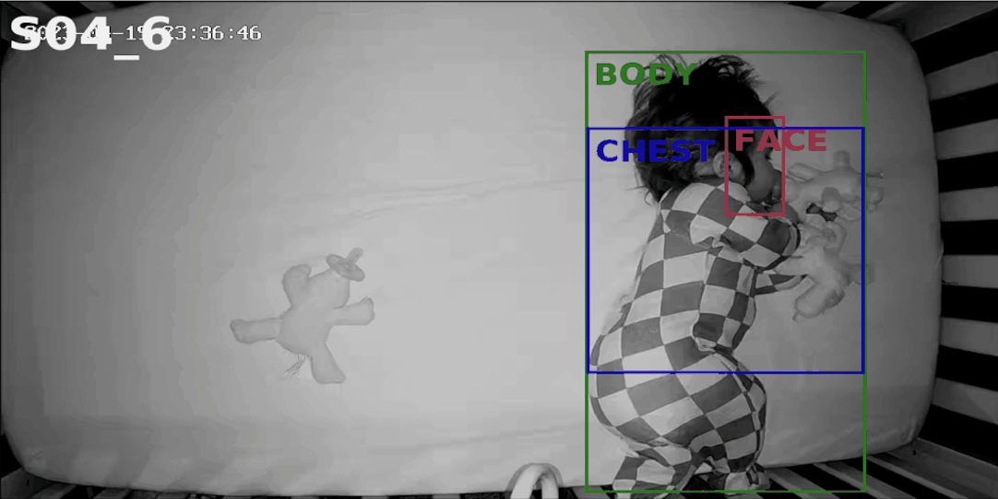
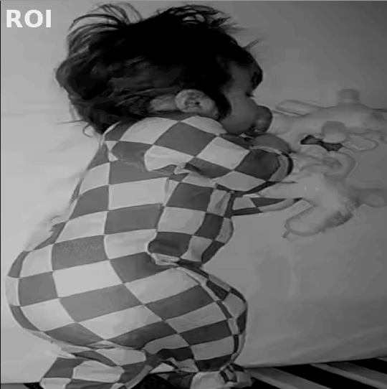
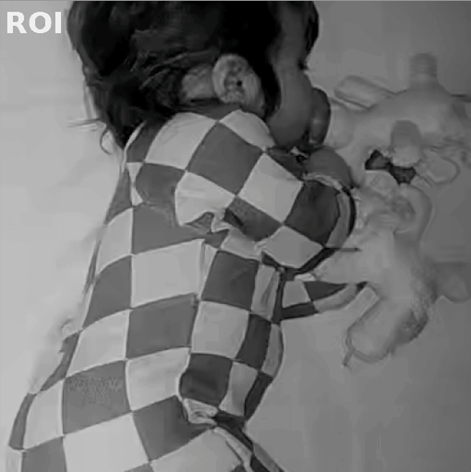
(a) Input Detection
(b) Body ROI
(c) Chest ROI

Slide 2
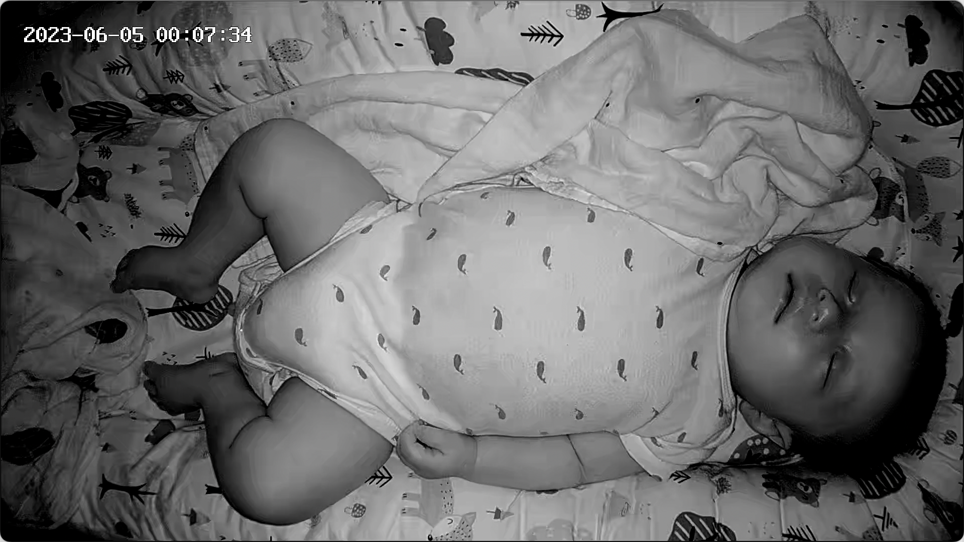
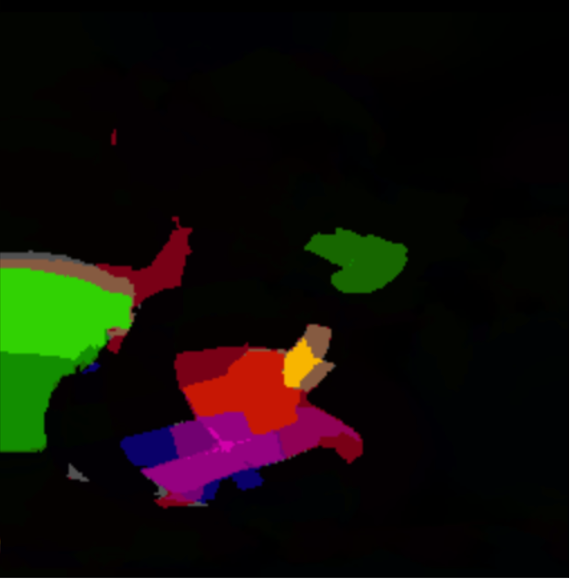
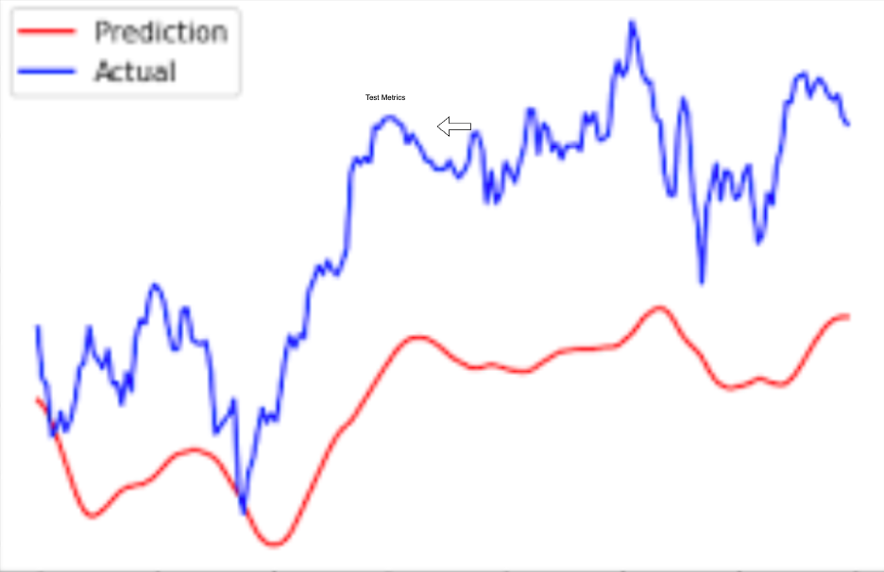
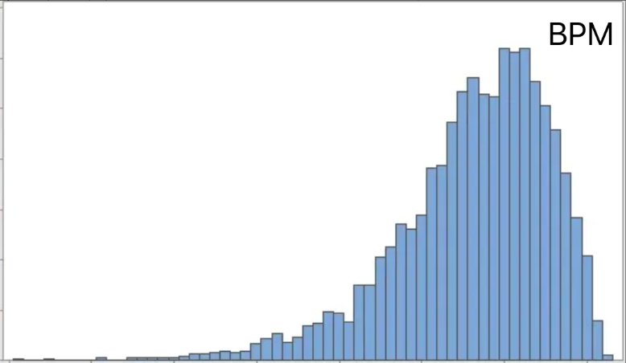
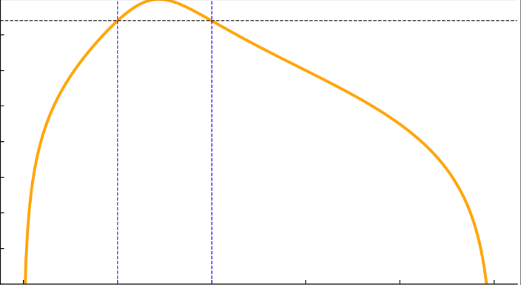
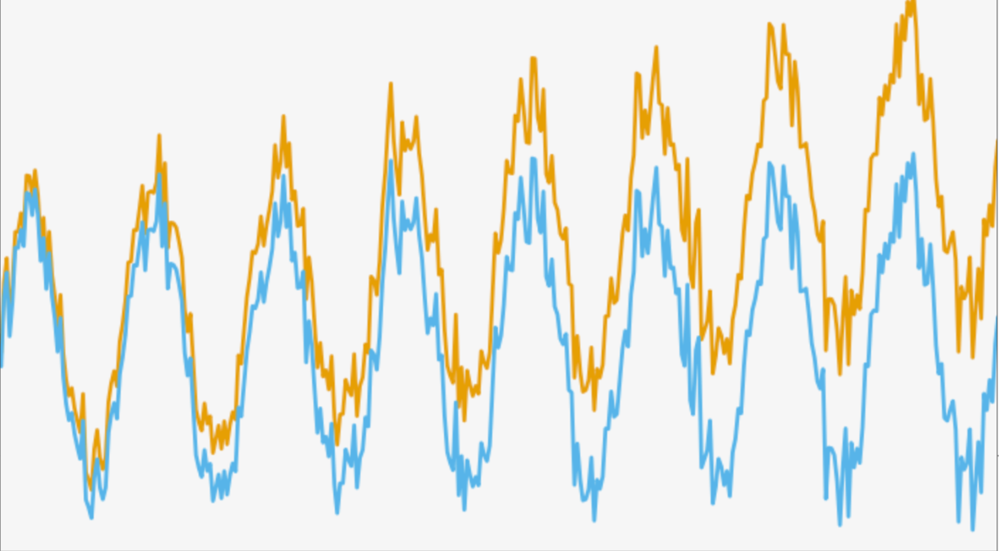
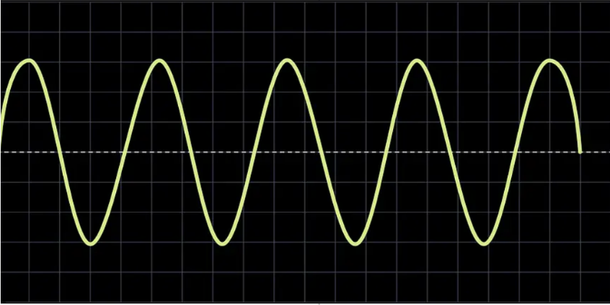
Preprocessing
Spatiotemporal Neural Network
Optical Flow
Video Frames
ROI Aggregation
Coarse2Fine, DeepFlow, Farneback, PCAFlow, TV-L1, RAFT
Convolution (Motion Branch)
3-ch flow
EfficientPhys
AIRFlowNet
Chest ROI
Convolution (Appearance Branch)
6-ch flow
Infant ROI Detection
Cropped ROI Frames
DeepPhys
Body ROI
MTTS-CAN
(V) Test Metrics
(MAE/RMSE/ρ)
(iv) Respiration Rate Estimation (BPM)
(iii) Bandpass Filter
(0.3-1.0Hz)
(ii) Detrend Signals
(i) Respiration Waveforms
Post-processing

Slide 3
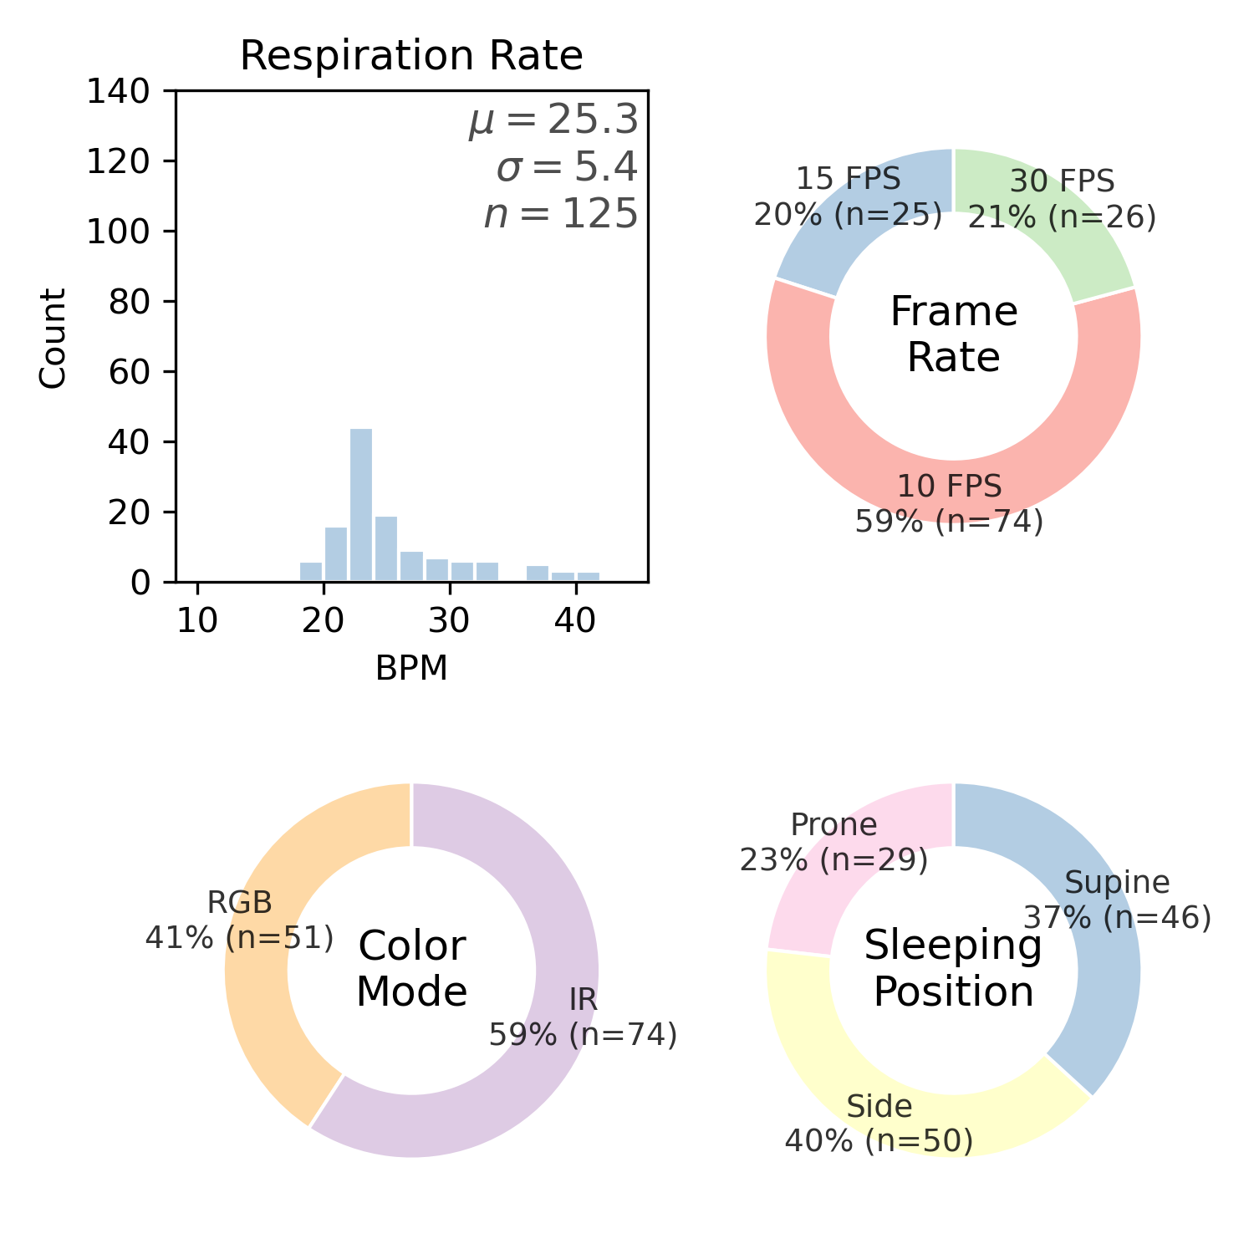
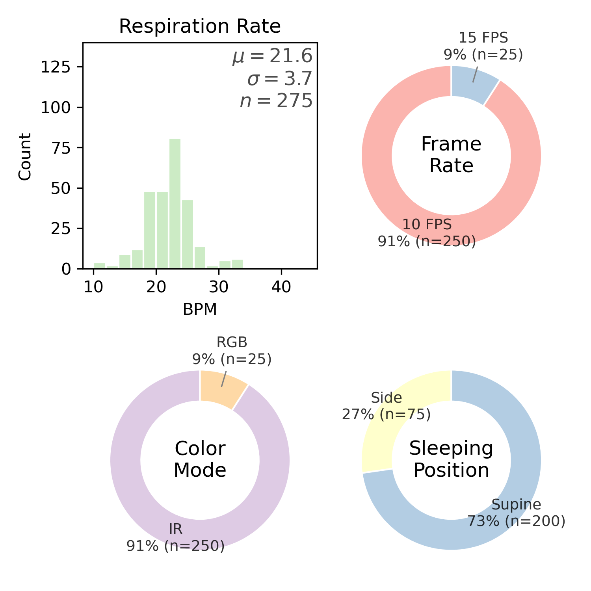
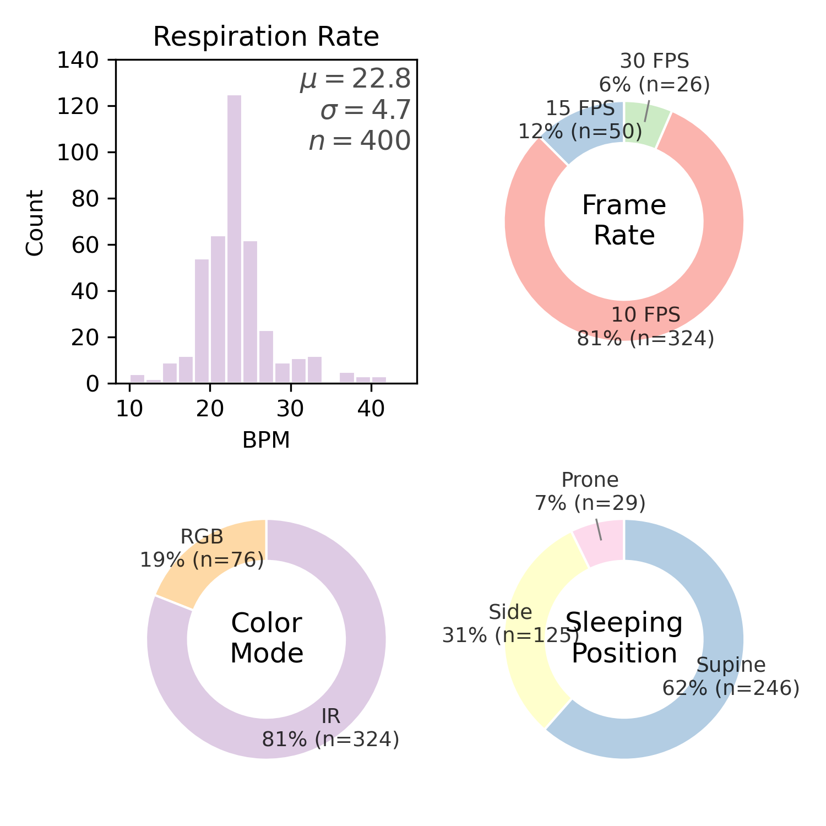
AIR-125
New Additions
AIR-400

